Slide 1




Mesoscale Light Sheet Microscopy To Study Post Myocardial Alterations in Rabbit Cardiac Structure
Steven M. Moreno¹, Sharika Mohanan¹, Eline Huethorst²,
Erin Boland², Camilla Olianti³, Leonardo Sacconi⁴,
Godfrey Smith², Caroline Müllenbroich¹
¹ School of Physics and Astronomy, University of Glasgow, UK
² School of Cardiovascular and Metabolic Health, University of Glasgow, UK
³ European Laboratory for Non-Linear Spectroscopy, Florence, Italy
⁴ Institute of Clinical Physiology (IFC) - CNR, Florence, Italy

Slide 2
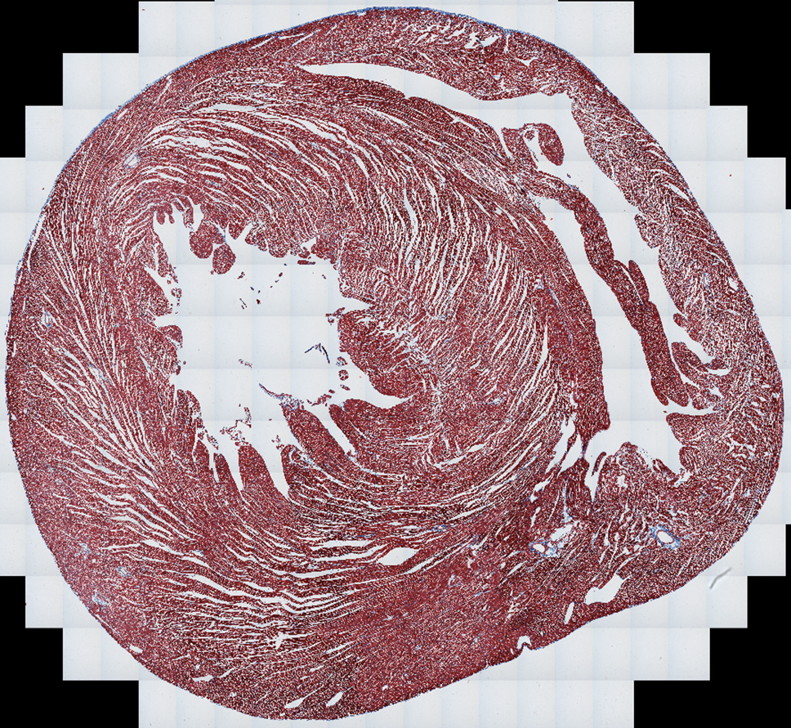
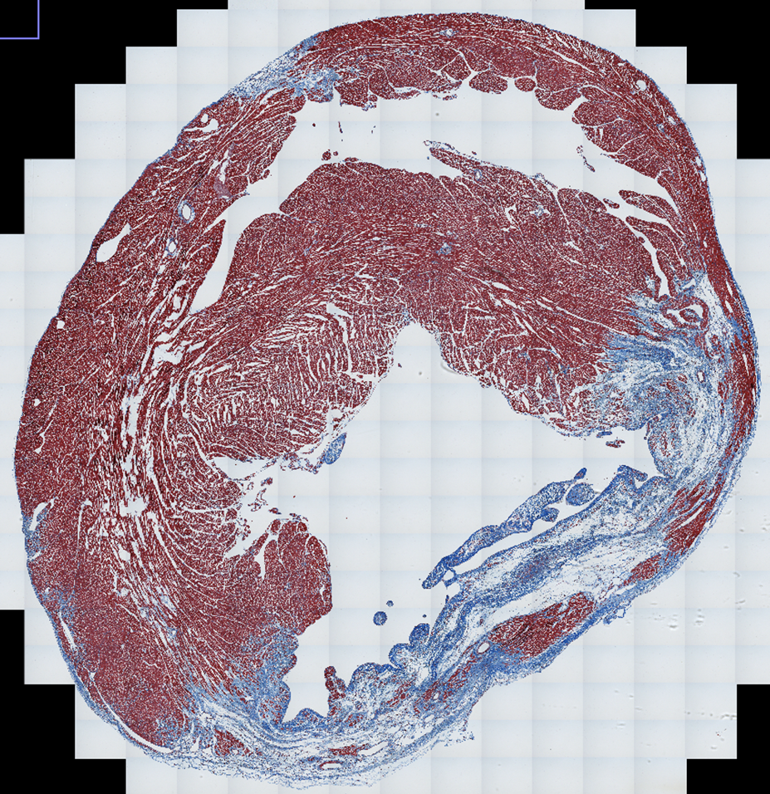
Introduction
1
Heart disease remains one of the most prevalent causes of death in the world today.
Damage caused by Myocardial Infarctions (MIs) to cardiac tissue can result in irregular electrical activity, gradual deterioration of the heart into organ failure [1].
Where and how this irregular activity occurs and how structural changes of the tissue post-MI relates to this remains poorly understood.
Figure: Comparison of two heart tissue sample cross sections between a Healthy Heart (upper) and a Heart Post-MI (lower)
[1] Oren, J. M., et al. Acute Myocardial Infarction. NIH-National Library of Medicine (2023)
Images courtesy of Prof. Godfrey Smith, University of Glasgow

Slide 3
Research Primary Aims and Goals
2
Document changes in cardiac structure in health and diseased animal model hearts
Obtain homogeneously resolved images at the cellular level of tissue samples
Develop a pipeline to obtain this information with high throughput and reliability
Quantify pipeline data to map healthy, border, and scar regions in diseased tissue

Slide 4
Tissue Processing Pipeline: Overview
3
Heart Extraction
Langendorff Perfusion
Tissue Clearing (CLARITY/CUBIC)
Tissue Staining
Tissue Mounting, RI matching
Cellular Resolution Imaging
Post Processing
Data Analysis
Statistcal Analysis
Quantitative Comparisons
CARDIOVASCULATURE SCIENCE
BIOCHEMISTRY
DATA COMPUTATION
OPTICS/ MICROSCOPY

Slide 5
Tissue Processing Pipeline: Phase 1
4
Heart Extraction
Langendorff Perfusion
Tissue Clearing (CLARITY/CUBIC)
Tissue Staining
Tissue Mounting, RI matching
Cellular Resolution Imaging
Post Processing
Data Analysis
Statistcal Analysis
Quantitative Comparisons
CARDIOVASCULATURE SCIENCE
BIOCHEMISTRY
DATA COMPUTATION
OPTICS/ MICROSCOPY

Slide 6

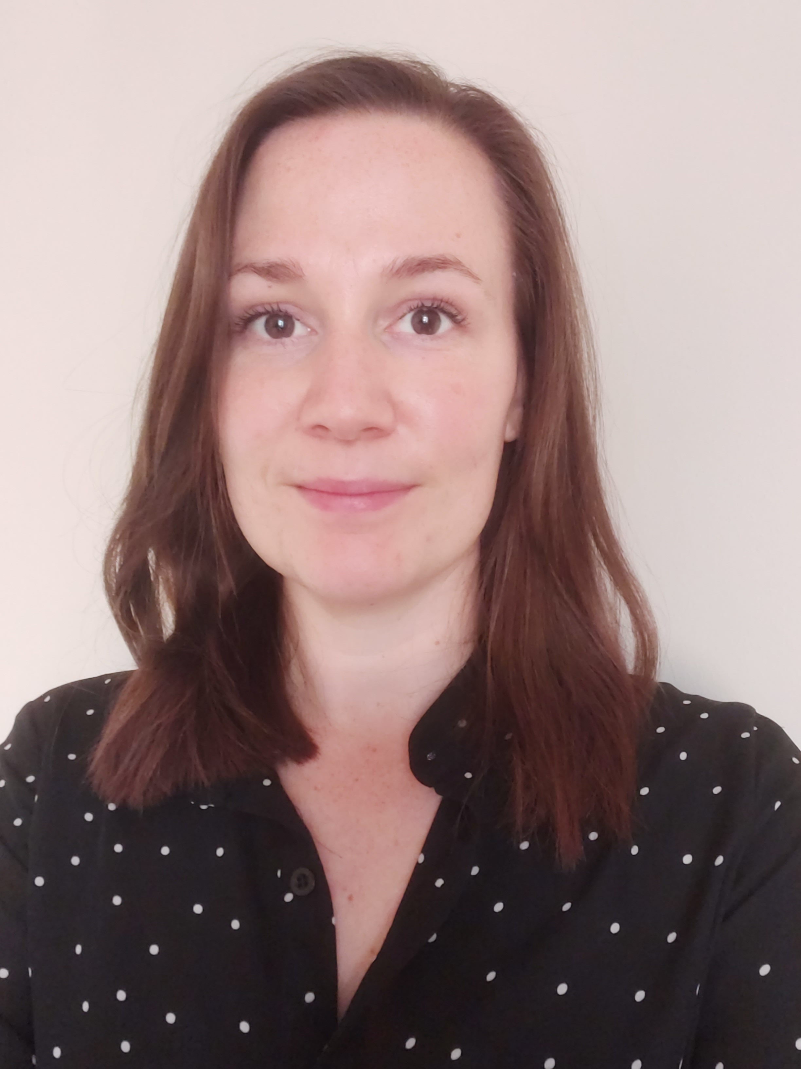
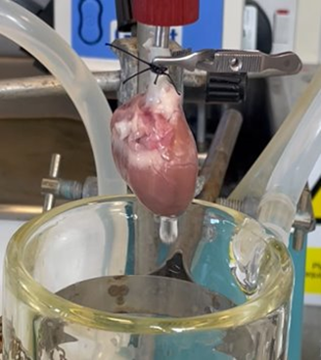
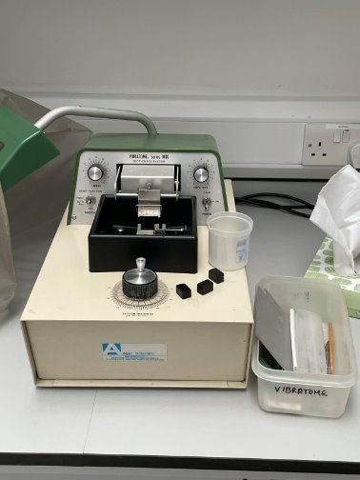
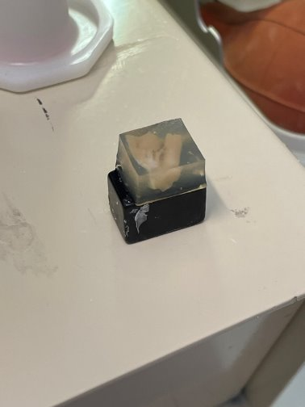
Tissue Preparation – Biological Steps
5
Erin Boland
Eline Huethorst
Whole hearts extracted and Langendorff perfused with Phosphate Buffered Saline (PBS) and Paraformaldehyde (PFA) to fixate tissue
Left Ventricle (LV) Wall Isolated, embedded in agar for slicing
Sliced into 0.4mm, 0.5mm, 1mm, 2mm thick slices
Heart samples undergo tissue clearing protocols compatible with cardiac tissue
CLARITY ➔ structural instability ➔ used only in sliced tissue
CUBIC-L/RA ➔ structurally stable ➔ used in sliced and whole heart samples
Cleared tissues stained using Wheat Germ Agglutin-Alexa Flour 488
Binds to cell surface glycoproteins in healthy and scar tissue after clearing
Figure (Left): Heart in Langendorff Perfusion Rig
Figures (Below):
Vibratome (left) and LV in agar (right)

Slide 7
Tissue Processing Pipeline: Phase 2
6
Heart Extraction
Langendorff Perfusion
Tissue Clearing (CLARITY/CUBIC)
Tissue Staining
Tissue Mounting, RI matching
Cellular Resolution Imaging
Post Processing
Data Analysis
Statistcal Analysis
Quantitative Comparisons
CARDIOVASCULATURE SCIENCE
BIOCHEMISTRY
DATA COMPUTATION
OPTICS/ MICROSCOPY

Slide 8
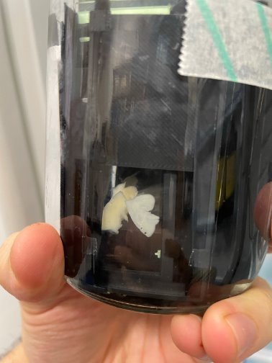
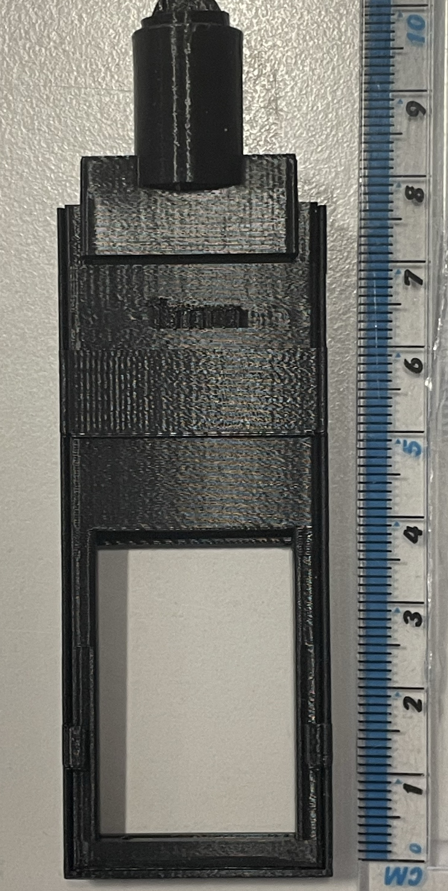
Sample Mounting Protocol
7
Figure (Left): Tissue suspended between slides in mount
Figure (Below): Photograph of 3D printed mount with diagram showing the separate components (below)
Tissue Clearing can cause tissue expansion
Heterogeneous axial expansion ➔ tissues held axially in place to prevent expansion
3D printed mount spacer holds slides at original slice thickness, halts axial expansion
Homogeneous lateral expansion ➔ expansion coefficient determined for later contextualization of analysis
Mount design reusable for imaging protocols
Mount Lid
Internal Spacer
External Sheath
Sample Between Slides

Slide 9
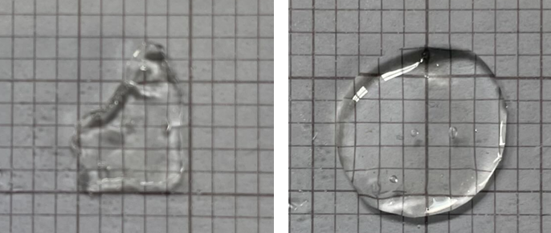
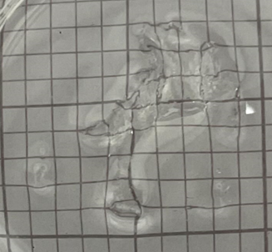
The CLARITY Protocol
8
4mm
4mm
Created by team at University of Stanford in 2013 for brain tissue initially [2]
CLARITY is a hydrogel-hybridized based method of tissue clearing
Acrylamide/Bis-acrylamide solution cocktail absorbed by the fixated tissue
Polymerization via nitrogen degassing to form hydrogel mesh in place of lipids in the tissue.
Weak acid, strong detergent solution washes out lipids from tissue via diffusion to homogenize RI
Published work from Italy shows CLARITY viable in cardiac tissue slices [3]
CLARITY protocol from this publication used as basis for our initial clearing protocol
Figure: CLARITY cleared 400 um tissue before (left) and after (right) submerging in Refractive Index Matching Solution (RIMS).
3mm
[2] Chung, K. et al. Structural and Molecular Interrogation of Intact biological system. Nature 497, 332-337 (2013).
Figure: CLARITY cleared tissue partially submerged in RIMS showing degree of RI matching capable.
[3] Olianti et al, Optical Clearing in Cardiac Imaging: A Comparative Study. Progress in Biophysics and Molecular Biology 168, 10-17 (2022)

Slide 10
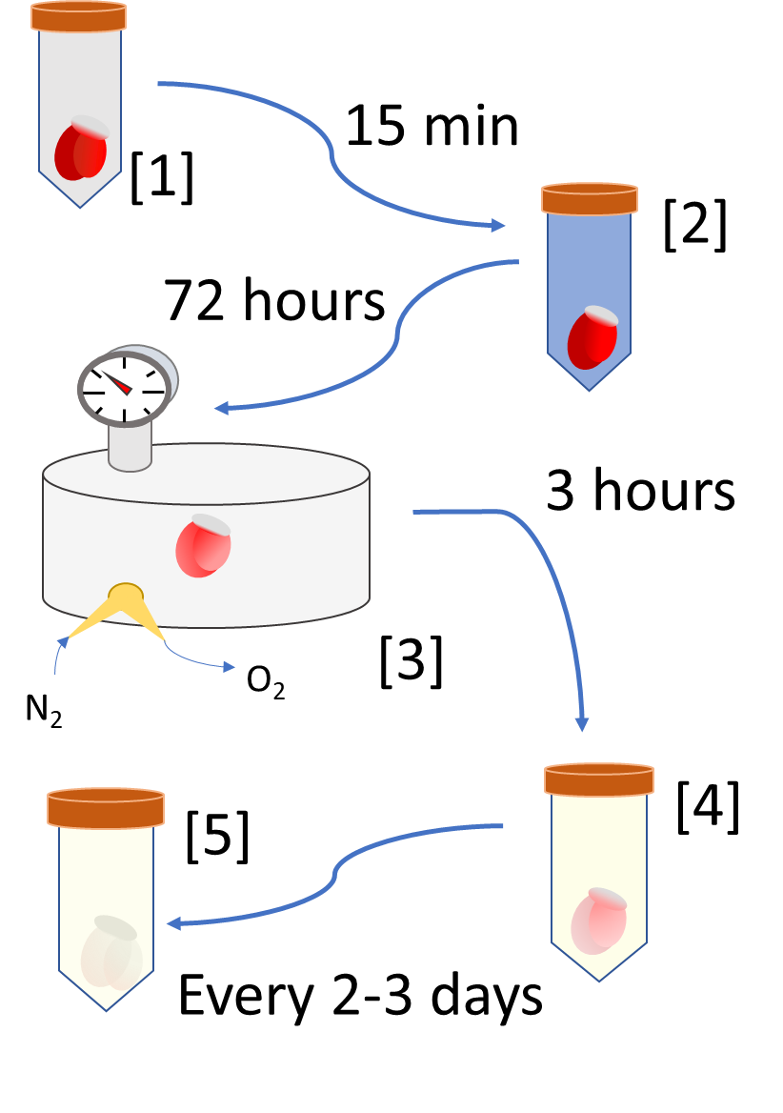
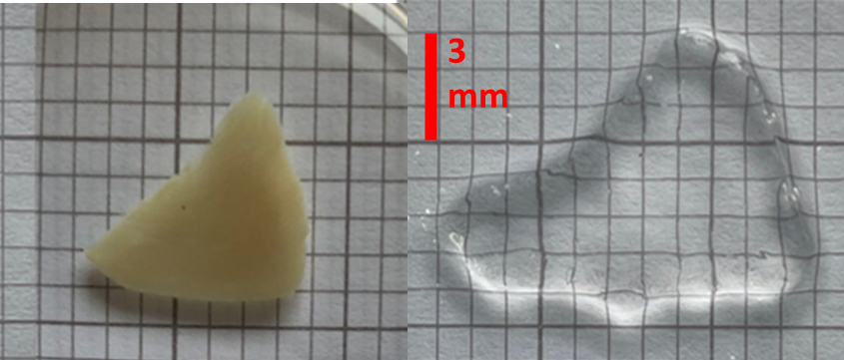
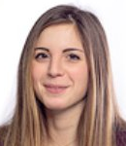
Tissue Preparation-CLARITY Tissue Clearing
9
PROCEDURE:
1. Washed in PBS to remove non-tissue molecules
2. Wash in Hydrogel solution (PFA/hydrogel monomers)
Sliced tissues placed into mounts
3. Degassed in N₂, tissue polymerized into hydrogel mesh.
4. Washed and Incubated in lipid removal solution
Sliced tissue removed from mount
5. Clearing solution changed every 2-3 days (for 6-7 months)
Figure: Sliced Hearts Before and After CLARITY Procedure
Camilla Olianti

Slide 11
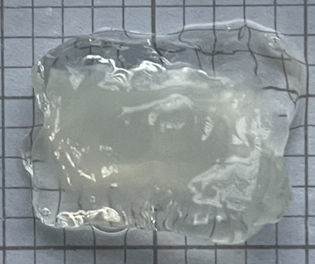
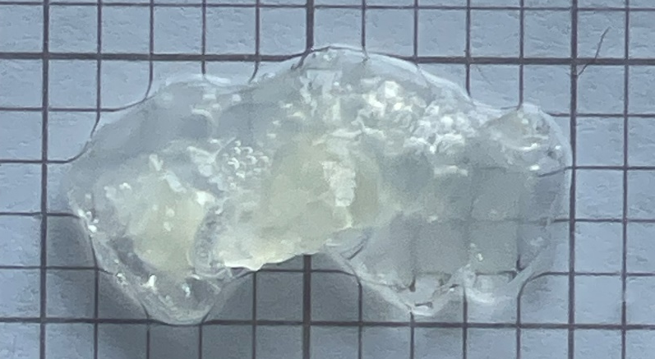
CLARITY Disadvantages
10
3mm
Expensive and complex protocol
Use of Expensive and Hazardous chemicals
Preparation and Solution Mixing and Storage Difficult
Use of pressurized gas always hazardous, requires safety training
Extremely Long Time Requirements
6-10 months for tissue slices
~1 year for entire hearts
Hard to spot mistakes till months after start of clearing
Cleared Samples extremely fragile, flimsy, prone to curling
Cleared whole hearts too structurally unstable to mount
Figures: CLARITY cleared 500um thick tissues that curled during 6 months of washing in detergent/ weak acid solution
3mm
CONCLUSION: CLARITY tissue clearing to be phased out for new protocol: CUBIC-L/RA

Slide 12
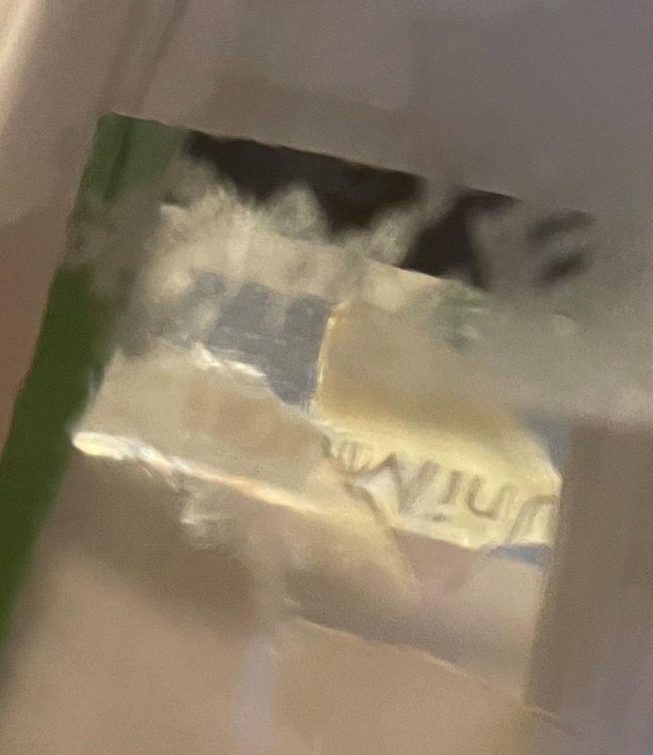
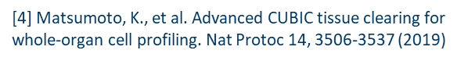
The CUBIC-L/RA Protocol
11
Created by CUBICstars team at University of Tokyo in 2018 for use in whole body clearing [4]
CUBIC-L is a hyperhydrating method of tissue clearing
Amino alcohol cocktail fully penetrates, partially denatures, and hydrates entire tissue [4]
Easy to make from scratch or order professionally premixed
CUBIC-RA used to diffuse freed lipids from tissue and homogenize tissue to new RI
CUBIC-RA Refractive Index = 1.54
Published work using CUBIC-L/RA on cardiac tissue is limited in scope and scale.
Proof-of-concept studies show it is viable with cardiac tissue [4].
CLARITY protocol modified for use with CUBIC-L and CUBIC-RA
Figure: 500um tissues undergoing CUBIC-L clearing inside mount after just 7 days of clearing

Slide 13


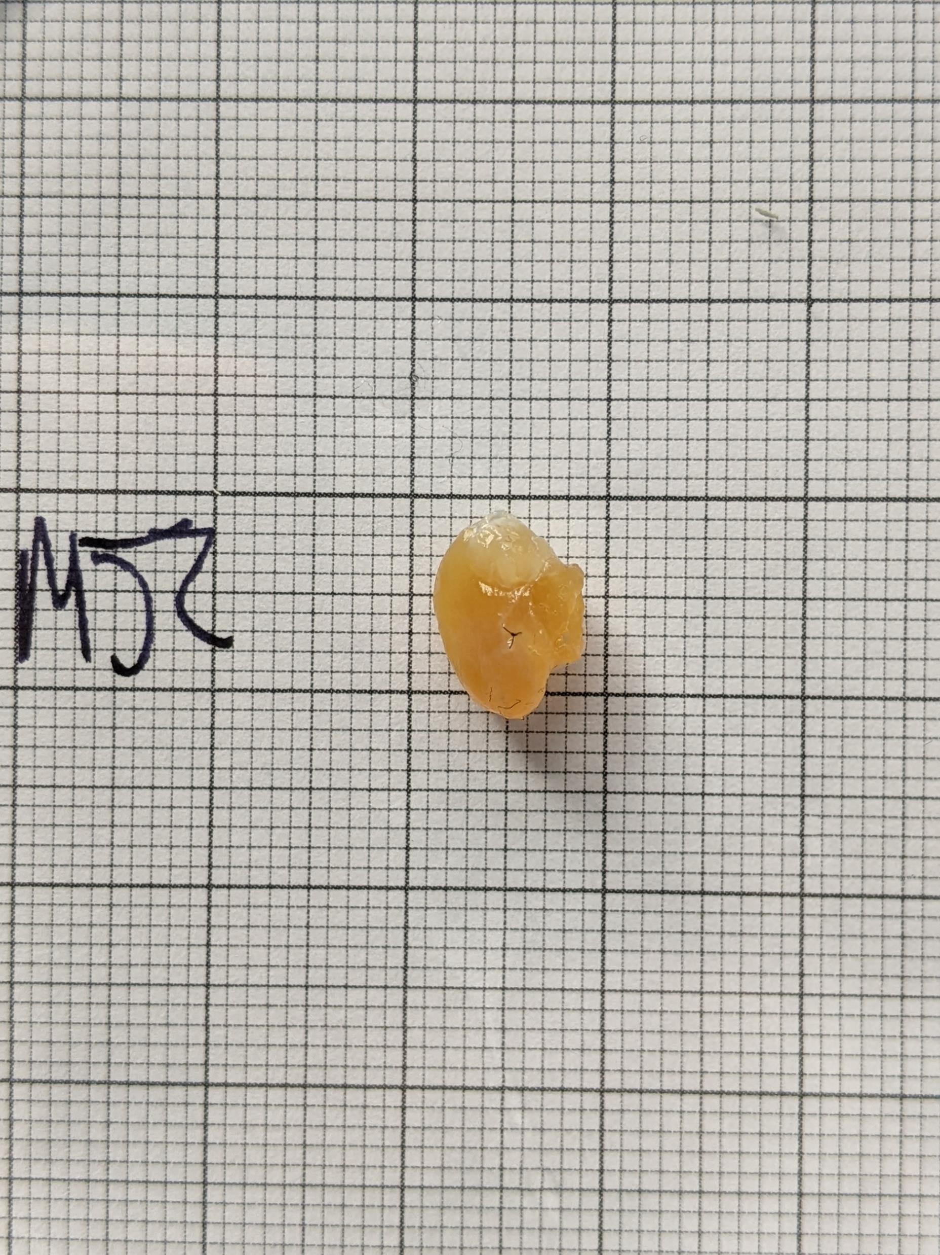
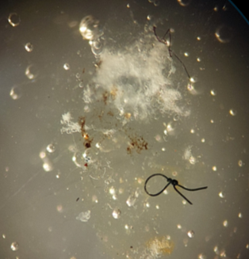
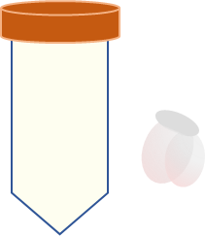
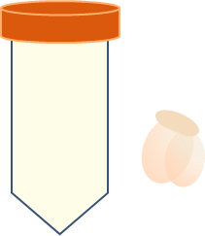
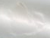
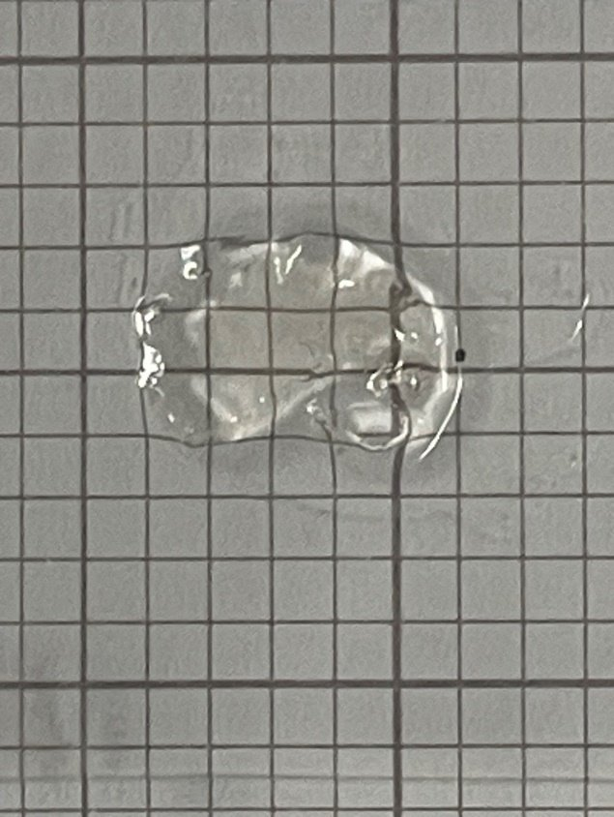
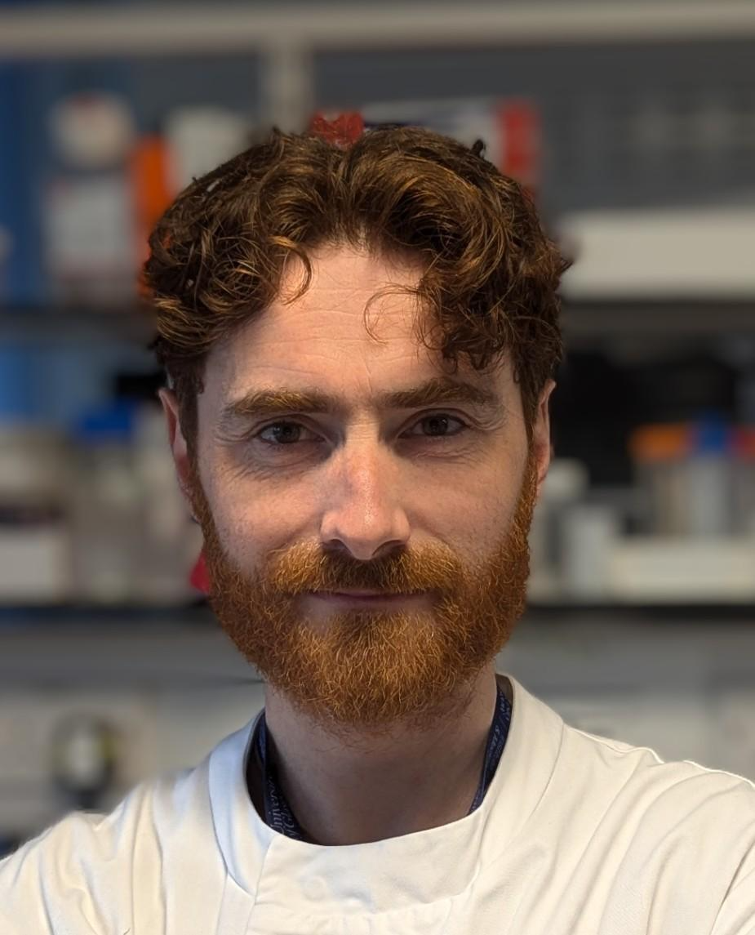
Tissue Preparation-CUBIC-L/RA Tissue Clearing
12
[1]
PROCEDURE:
1. Wash in PBS to remove non-tissue molecules
2. Wash in CUBIC-L solution
Sliced tissue placed into mounts
3. CUBIC-L solution changed every 3-4 days (for 1-2 weeks)
4. Washed in CUBIC-RA to RI match
Slice tissues removed from mounts
15 min
[2]
5mm
Figure (below): Cleared tissue slice before (left) and after (right) CUBIC-RA.
[3]
1-2 weeks
Figure (above): Murine Heart after CUBIC-L (left) and after (right) CUBIC-RA Washing
Alexander Johnston

Slide 14

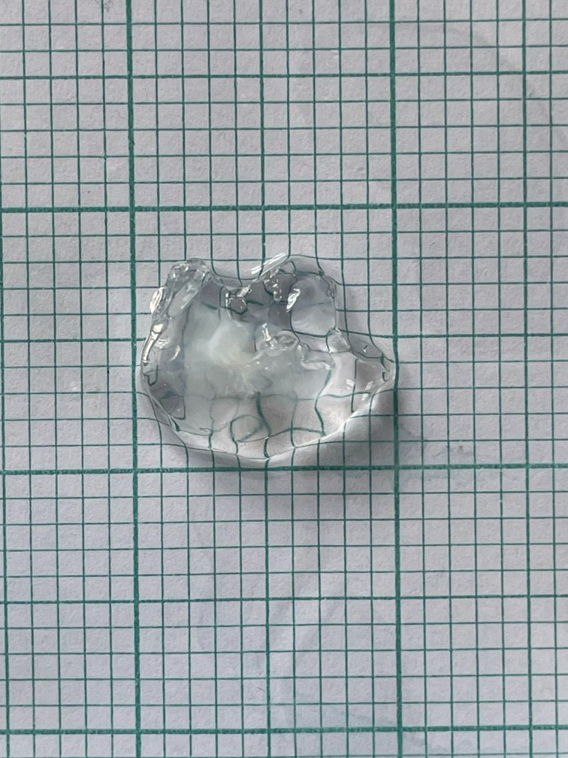
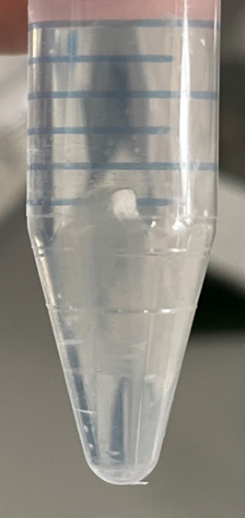
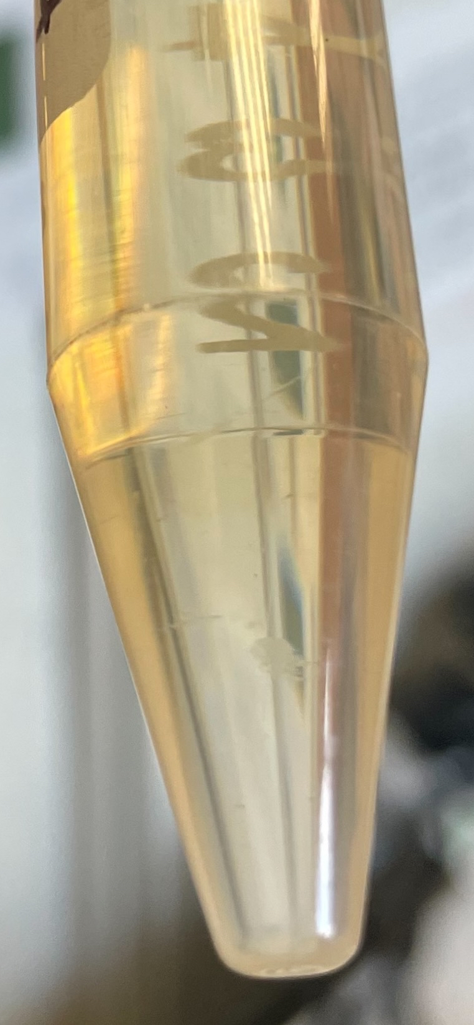
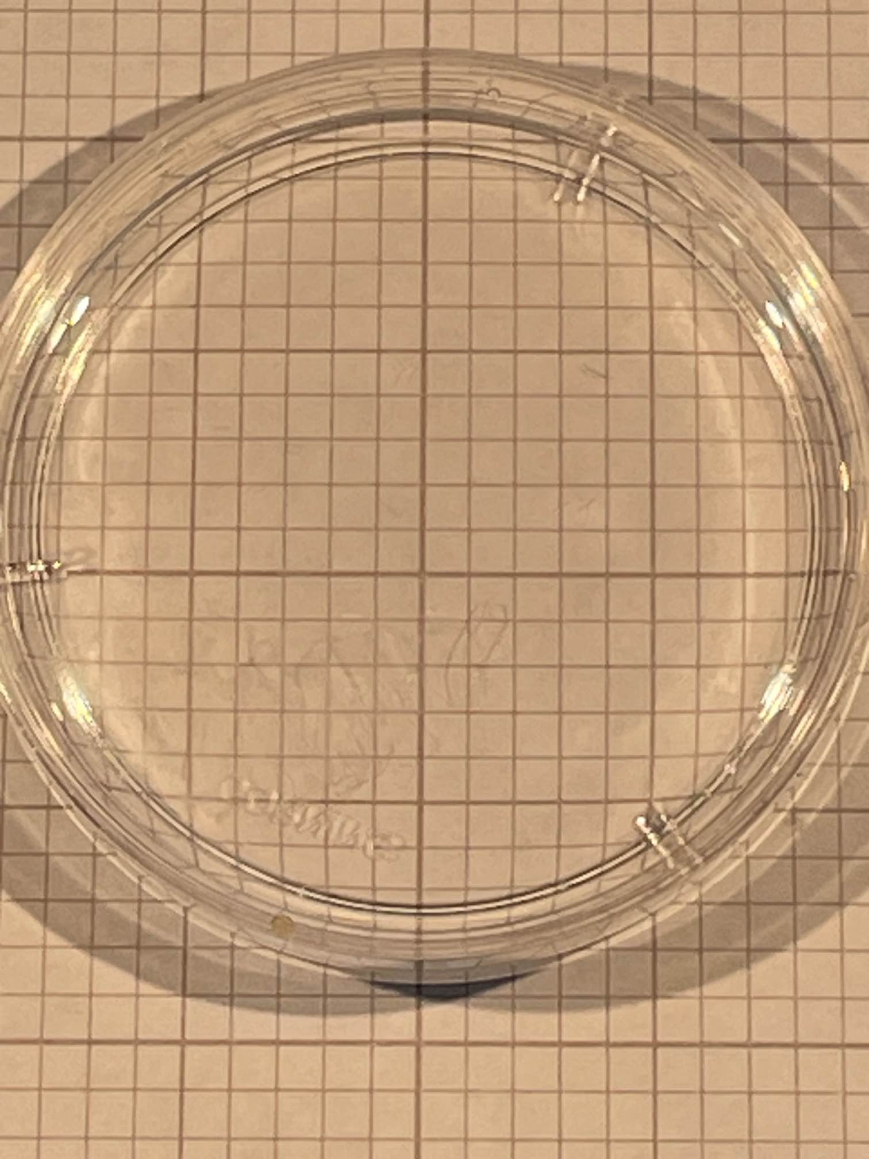
COMPARISON OF CLEARING PROTOCOL RESULTS
13
CLARITY
CUBIC-L/RA
Alexander Johnston
Giedre Astrauskaite
5mm
5mm
3mm
3mm

Slide 15
Tissue Processing Pipeline: Phase 3
14
Heart Extraction
Langendorff Perfusion
Tissue Clearing (CLARITY/CUBIC)
Tissue Staining
Tissue Mounting, RI matching
High Resolution Imaging
Post Processing
Data Analysis
Statistcal Analysis
Quantitative Comparisons
CARDIOVASCULATURE SCIENCE
BIOCHEMISTRY
DATA COMPUTATION
OPTICS/ MICROSCOPY

Slide 16
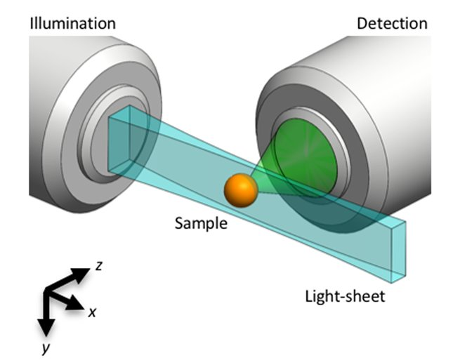
Light Sheet Microscopy
15
Illumination via scanning gaussian beam across entire x-y plane of sample
Pros
Low Photobleaching
Can image large volume samples
Cons
Complex Sample Mounting
Requires multiple TBs of Data Storage
Spherical aberration susceptible by traversing open air regions to sample
Keomanee-Dizon et al, Rev. Sci. Instrum., 2020

Slide 17
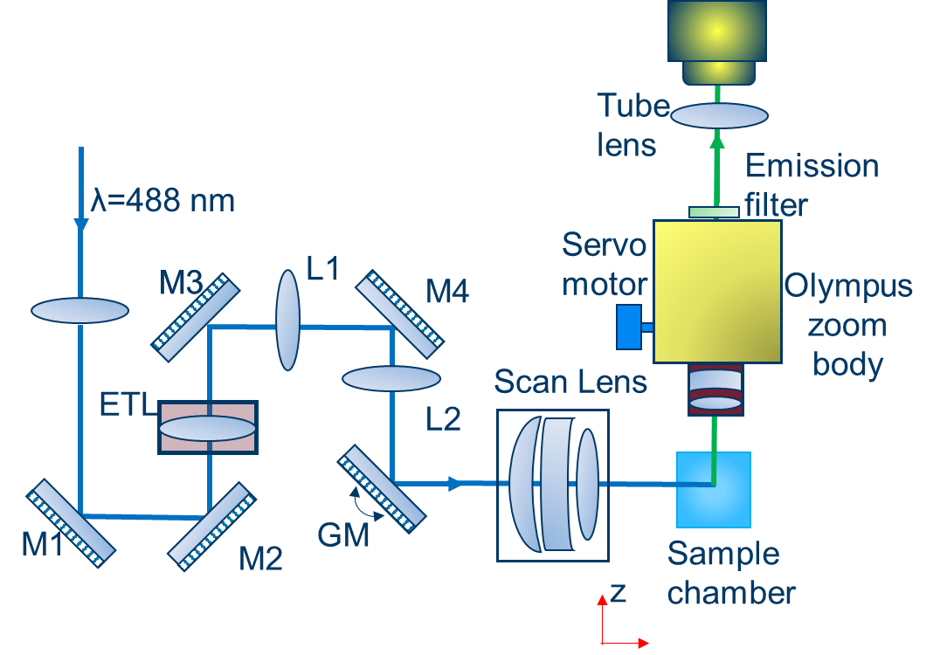
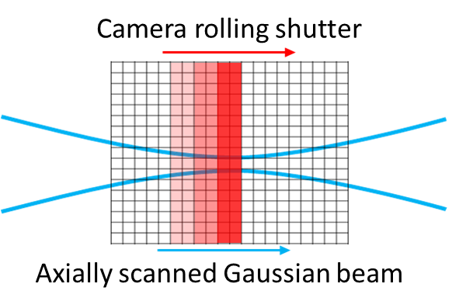
mesoSPIM (Mesoscale Selective Plane Illumination Microscopy)
16
Light Sheet Microscope utilizing Axially Scanned Light Sheet Microscopy (ASLM)
Narrow Beam Waist shifted via galvo mirrors and electronically tunable lenses (ETLs)
High, Isometric Axial Resolution across mesoscale volumes (mm³-cm³)
Figure (below): Excitation Beam Pathway of mesoSPIM using ETLs and Galvo Mirrors
Figure (right): ASLM movement of beam waist in sequence with rolling shutter of camera
Voigt et al, Nat. Methods, 2019

Slide 18
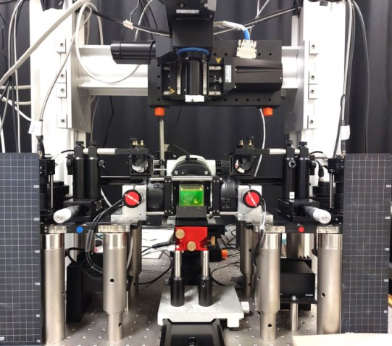
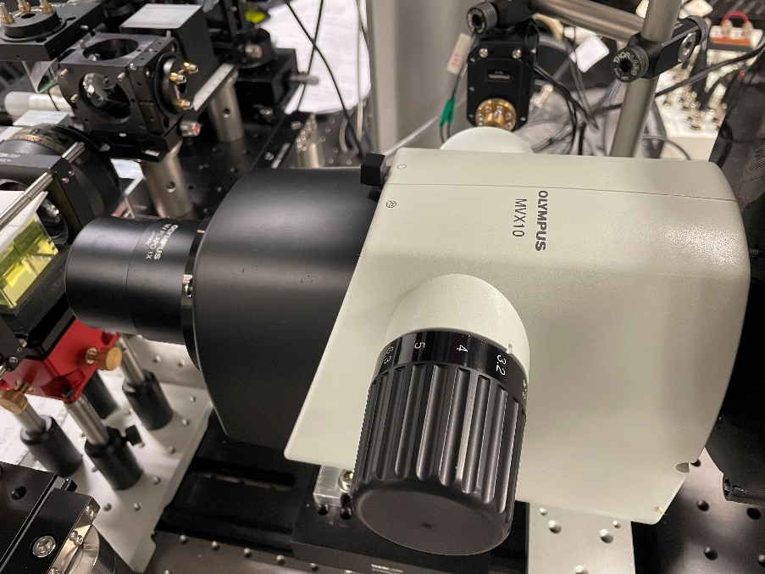
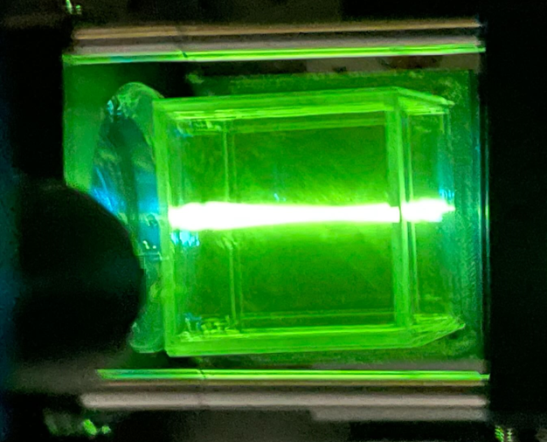
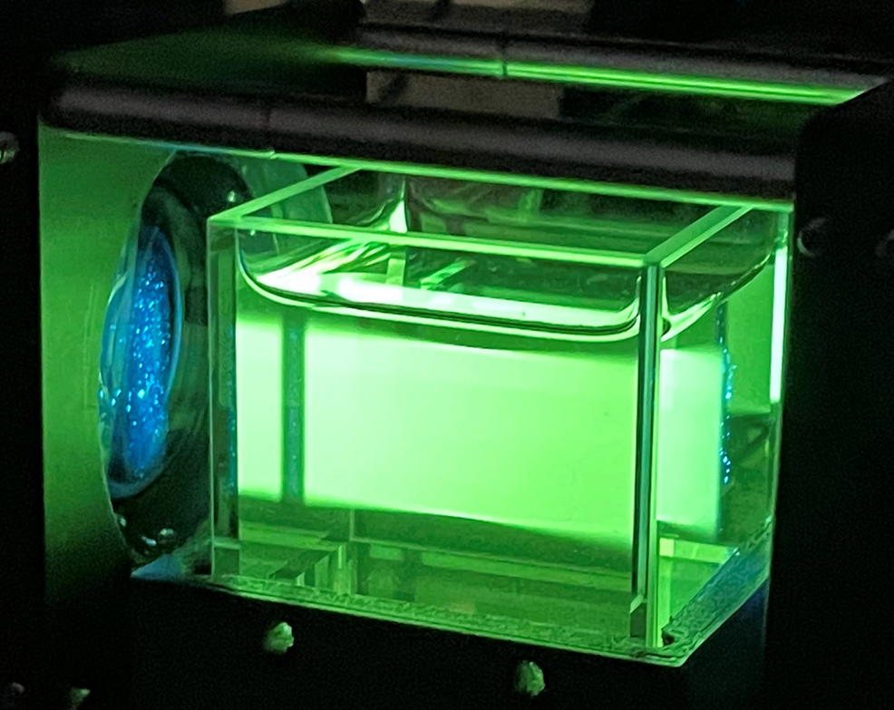
mesoSPIM version 5
17
Resolution Achievable:
Lateral: 5.07 ± 0.76 μm
Axial: 6.51 ± 0.46 μm
Magnification Range:
x0.8-x6.3

Slide 19
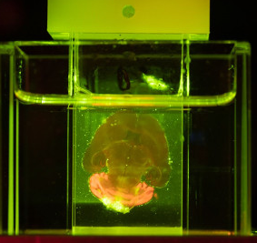
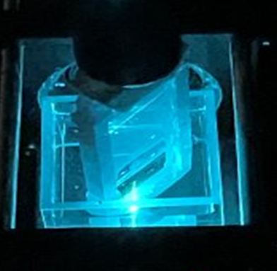
18
Tissue Slice vs Whole Heart Mounting
https://mesospim.org/gallery/#
Emission
Whole Organ Samples (Established Approach)
Mobile Inner Cuvette
Stationary Outer Cuvette
Sliced Organ Samples (Novel Approach)
Mobile Inner Custom Mount
Stationary Outer Cuvette
x
z
Excitation
Scan direction
x
Emission
z
Optical axis
Figures: Comparison images (left) and diagrams (right) of tissue mounting between prior research (upper) and my research (lower)
^{45°}
Excitation
^{90°}
Scan direction

Slide 20
Tissue Processing Pipeline: Phase 4
19
Heart Extraction
Langendorff Perfusion
Tissue Clearing (CLARITY/CUBIC)
Tissue Staining
Tissue Mounting, RI matching
High Resolution Imaging
Post Processing
Data Analysis
Statistcal Analysis
Quantitative Comparisons
CARDIOVASCULATURE SCIENCE
BIOCHEMISTRY
DATA COMPUTATION
OPTICS/ MICROSCOPY

Slide 21
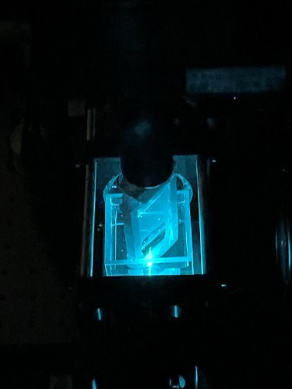
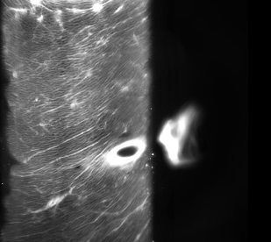
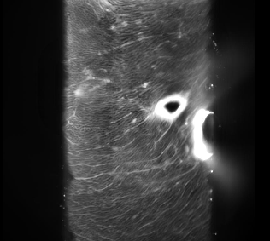
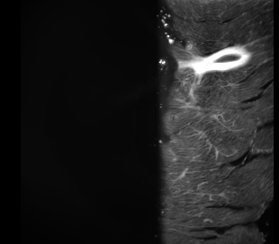
20
Tissue Slice Imaging Challenge
Cartesian Scanning
Sheared dataset
z'
x'
Raw image stack
θ
computational
shearing
z
z scan
x
z'
x'
x
z
z
x
Scan direction
Excitation Pathway
Mount Orientation
Detection Pathway
500 µm
45º

Slide 22
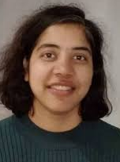
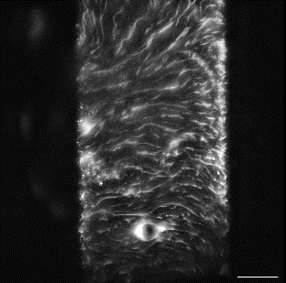
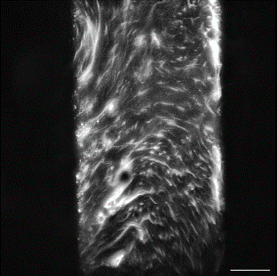
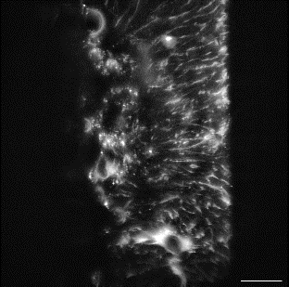
21
Tissue Slice Imaging Solution
Oblique Scanning
Sharika Mohanan
x = z tan(θ)
computational
processing
θ
x' scan
z
x
z'
x'
z'
x'
Raw image stack
Unsheared dataset
Scan direction
Excitation Pathway
Mount Orientation
Detection Pathway
45º
500 µm

Slide 23
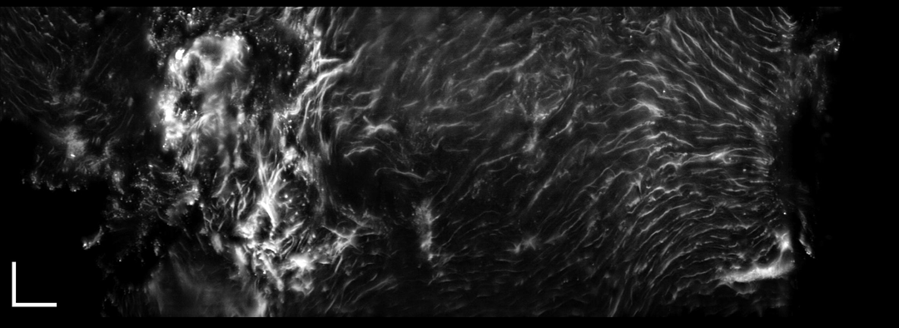
22
Tissue Slice Imaging Solution
Oblique Scanning modifications made to mesoSPIM control program python code
Image De-skewing Program created by Dr. Sharika Mohanan
Tissue image stacks obtained are now across z’-plane (see example image below)
Image stack ordered as if tissue was on original z-plane, no angled orientation
Sharika Mohanan
Image Stack Direction
z'
x'
Scan Direction
FOV: 9000 µm x 3000 µm x 300 µm

Slide 24
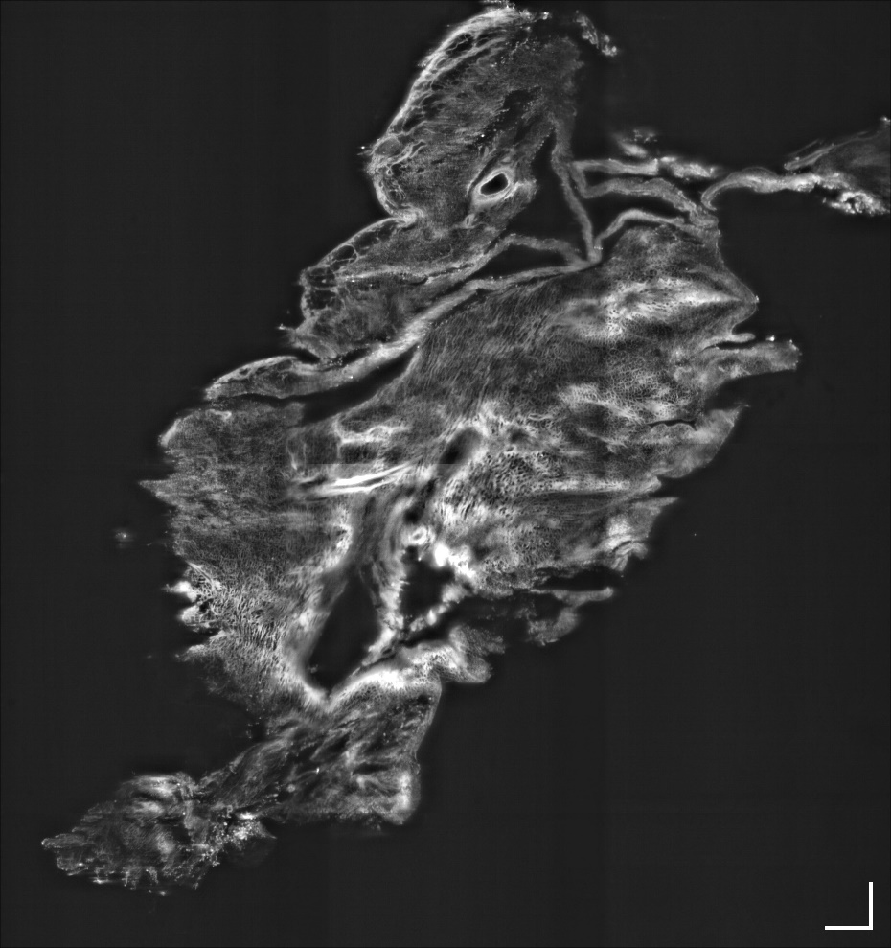
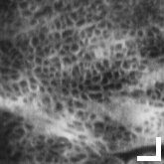
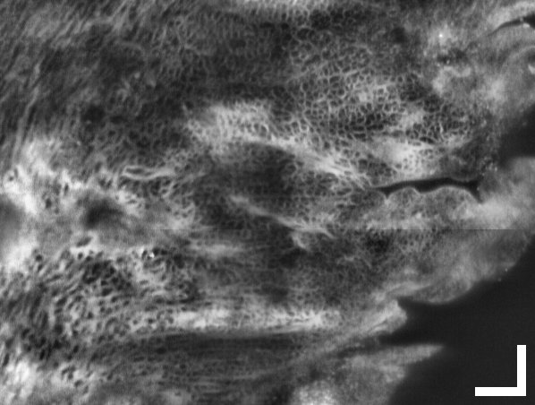
Results
23
Preliminary Tissue Slice Imaging Results
500 µm
25 µm
250 µm
De-skewed Image of CUBIC-L/RA cleared, 500um Tissue Slice
Tissue Stained using WGA/AF 488
Proof of Pipeline Viability

Slide 25
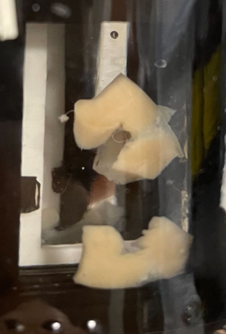



Conclusion and Next Steps
24
Advantages of Cardiac Imaging Procedure:
Can document cardiac structure in rabbit model hearts
Reduces changes to structure caused by thin tissue slicing
Can obtain images with isometric resolution at a cellular level
Optimizes new and commonplace clearing and staining protocol combinations
Next Steps
Complete characterization of newly upgraded mesoSPIM system
Quantify imaging data to map damaged regions in diseased tissue
Innervation volume and fibroblast populations as means of distinguishing healthy, damaged, and scar cardiac tissue
Create reliable, high throughput protocol to map tissue regions across sliced, partial, and eventually whole organ samples
STATISTICAL ANALYSIS
QUANTITATIVE COMPARISONS

Slide 26




Acknowledgements
Institute of Clinical Physiology – CNR, Florence, Italy
Dr. Leonardo Sacconi
European Laboratory for Non-Linear Spectroscopy, Florence, Italy
Dr. Camilla Olianti
Physics and Astronomy:
Dr. Caroline Müllenbroich (Advisor)
Dr. Sharika Mohanan
Giedre Astrauskaite
Cardiovascular and Metabolic Health:
Prof. Godfrey Smith
Dr. Alexander Johnson
Dr. Eline Huethorst
Dr. Erin Boland
#UofGWorldChangers
@UofGlasgow

